Slide 1
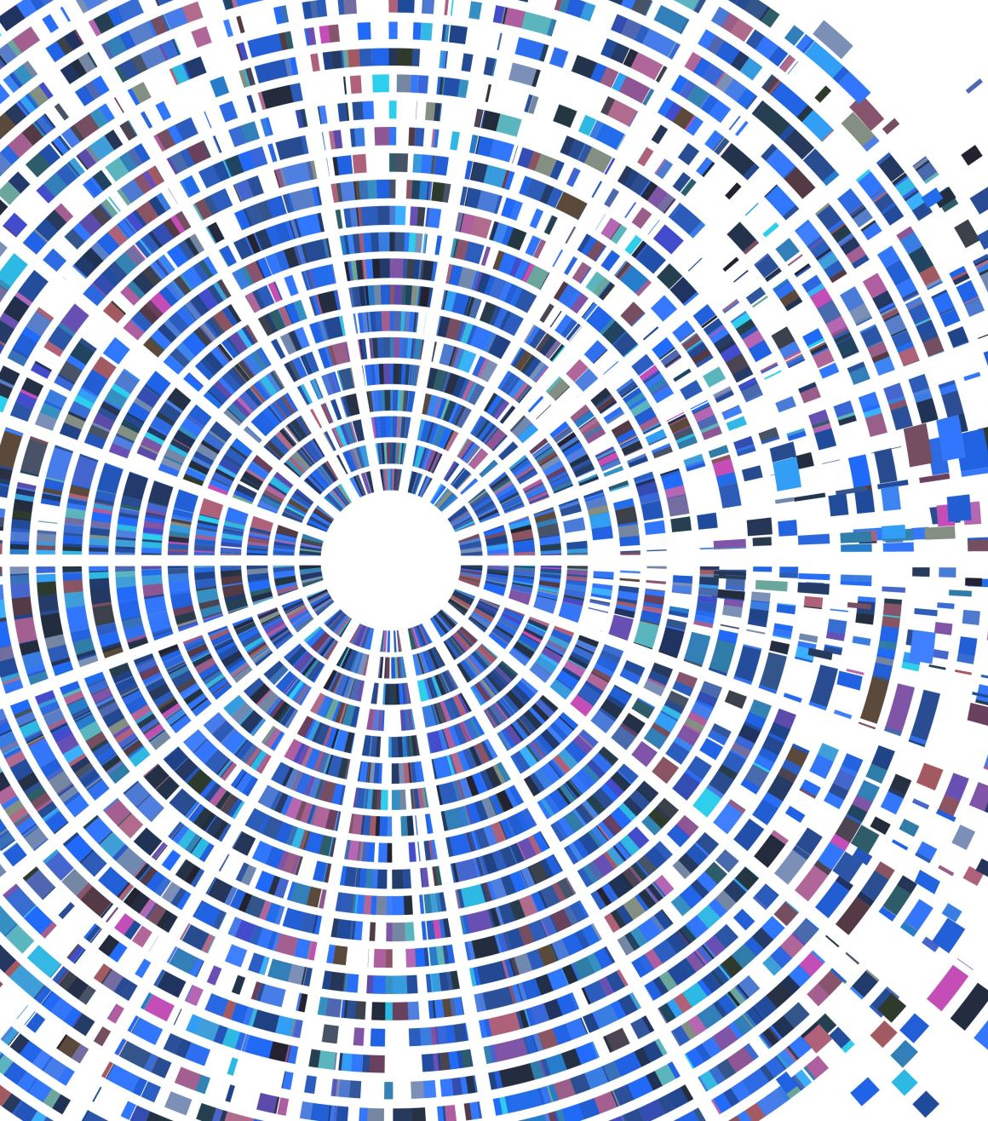
Radiopharmaceutical Therapy
RT4220 – Lecture #14
Kedree Proffitt
WSU
11/11/2025

Slide 2
Learning Objectives
Review concepts of radiation protection and safety
Discuss an overview of radiopharmaceutical procedures
Explain the process of Lu-177 radiopharmaceutical procedures

Slide 3

Review of Rad Protection and Safety
So safe, so cool!

Slide 4
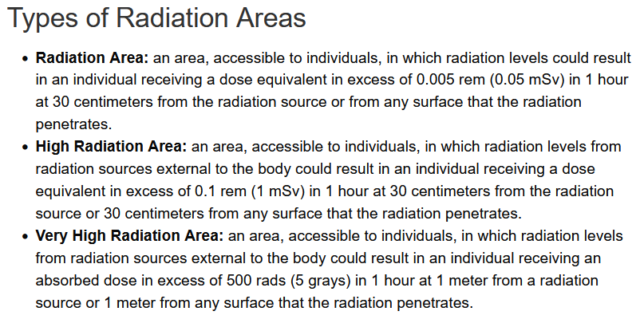

Slide 5
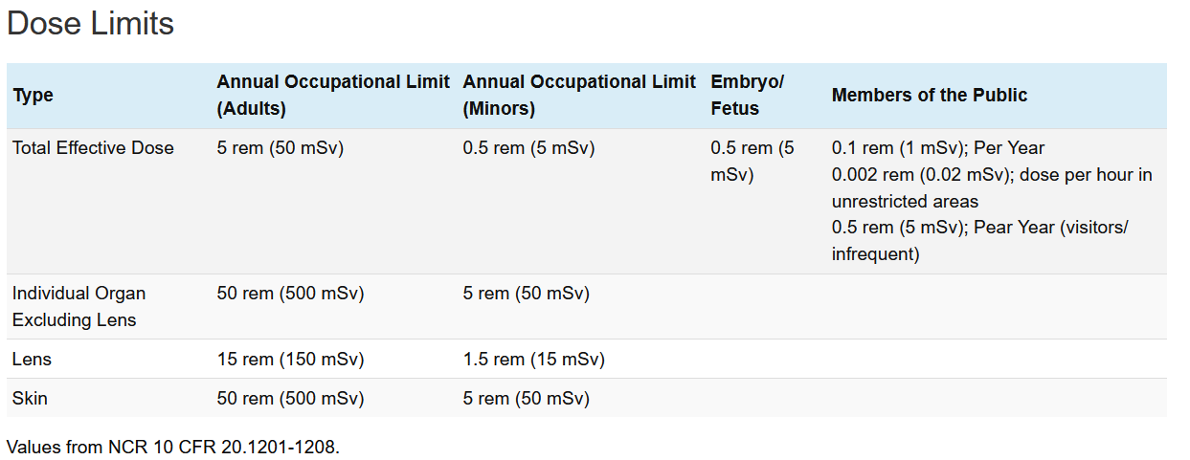

Slide 6
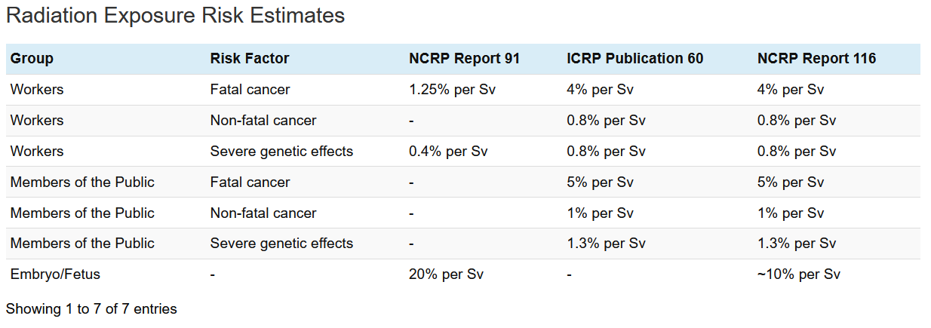

Slide 7
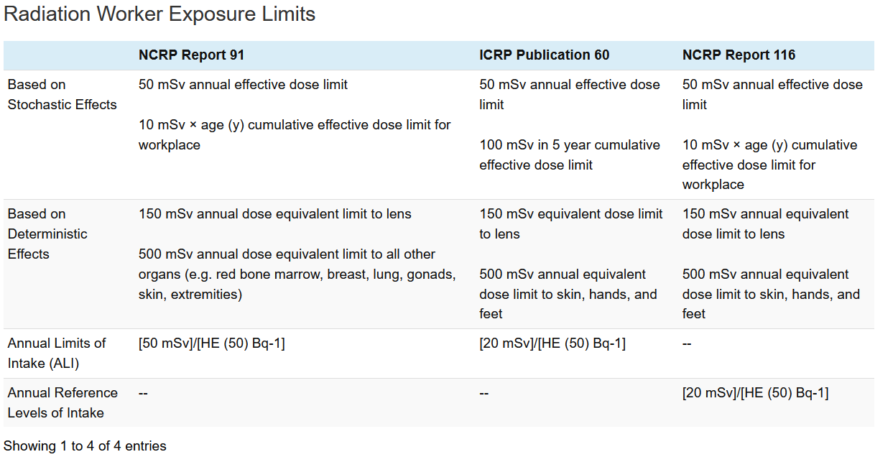

Slide 8
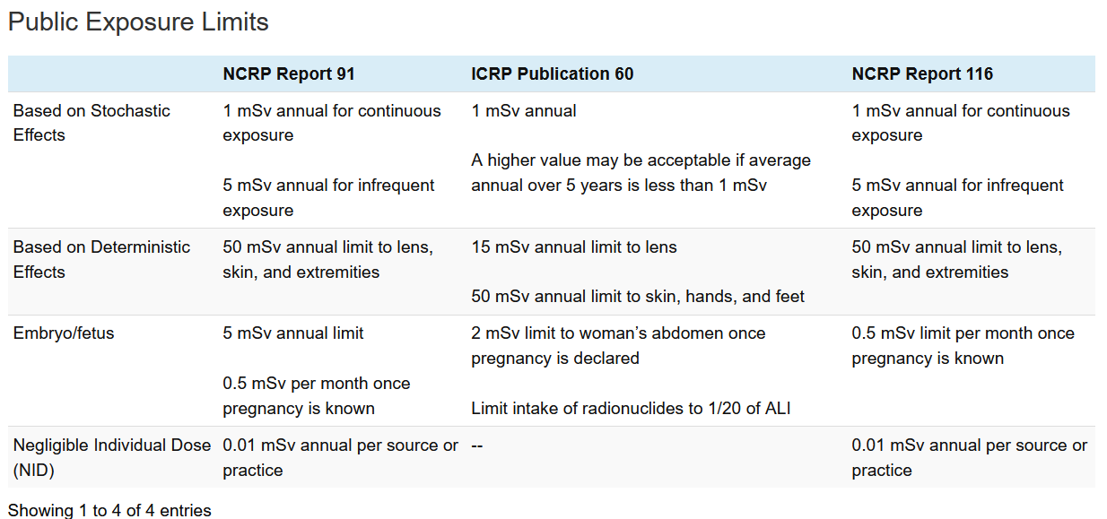

Slide 9
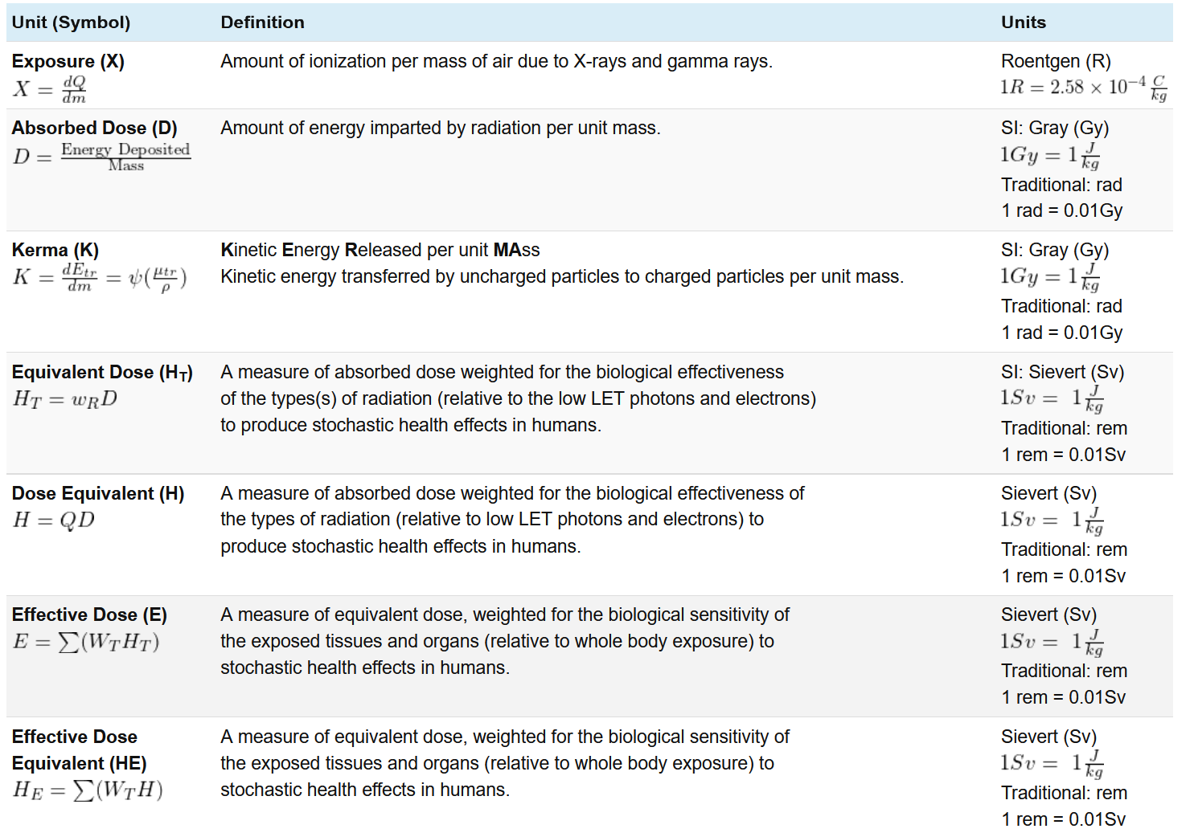
C/kg is SI

Slide 10
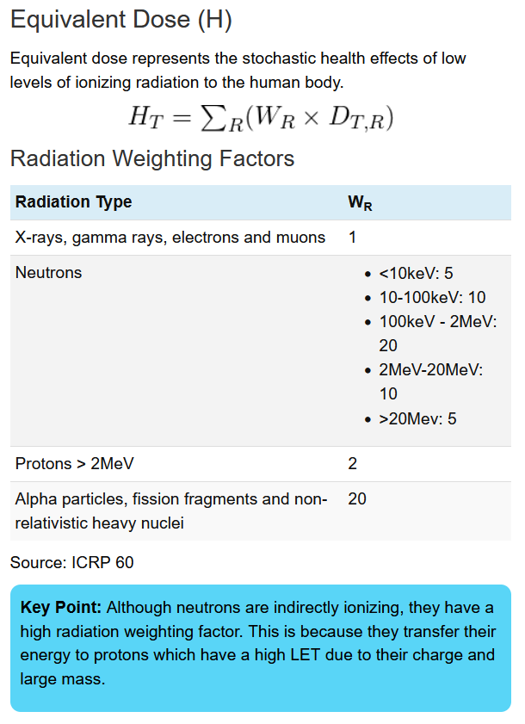

Slide 11
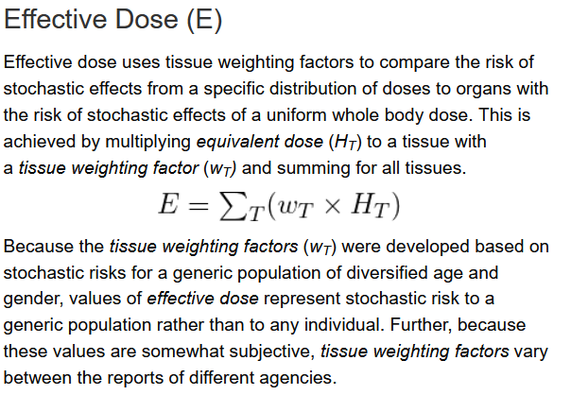
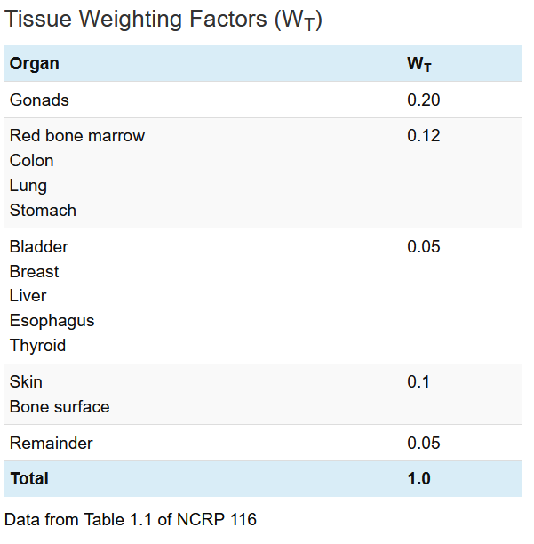

Slide 12
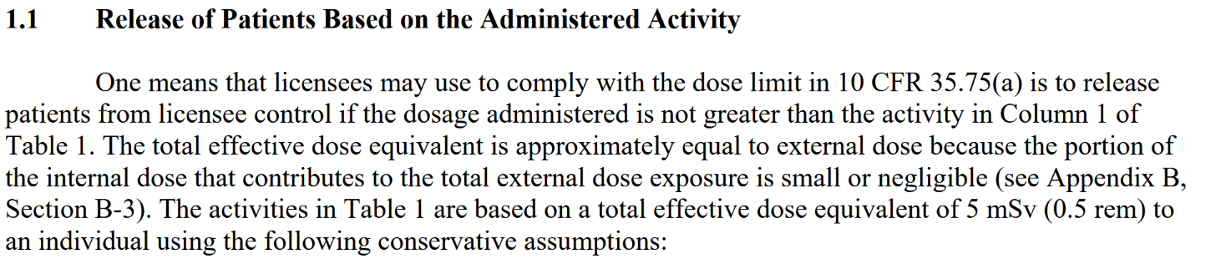
Average annual dose for an American is quoted to be about 6.4 mSv (3.2 mSv natural, 3.2 mSv man-made)

Slide 13
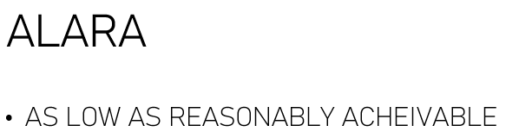
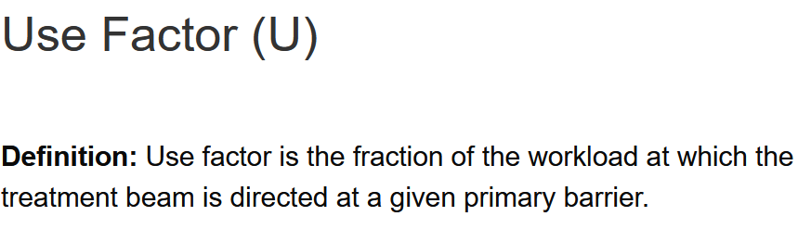
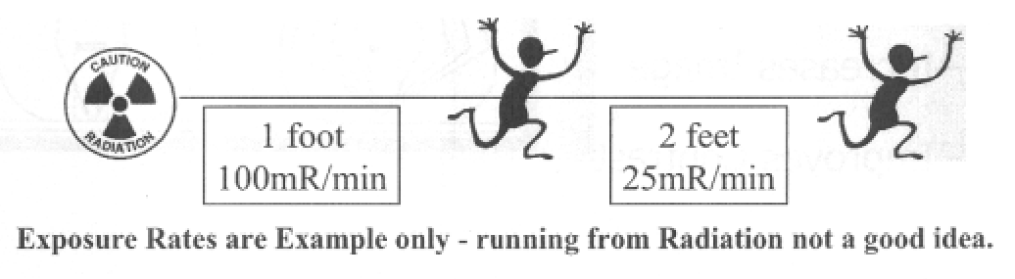
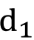
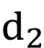
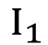
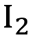
Lead aprons are near useless for HIGH ENERGY GAMMA EMISSIONS.
GM survey meters are great for finding tiny, somewhat low activity things!
The Inverse Square Law: $\frac{I_{1}}{I_{2}}=\frac{{\left(d_{2}\right)}^{2}}{{\left(d_{1}\right)}^{2}}$

Slide 14
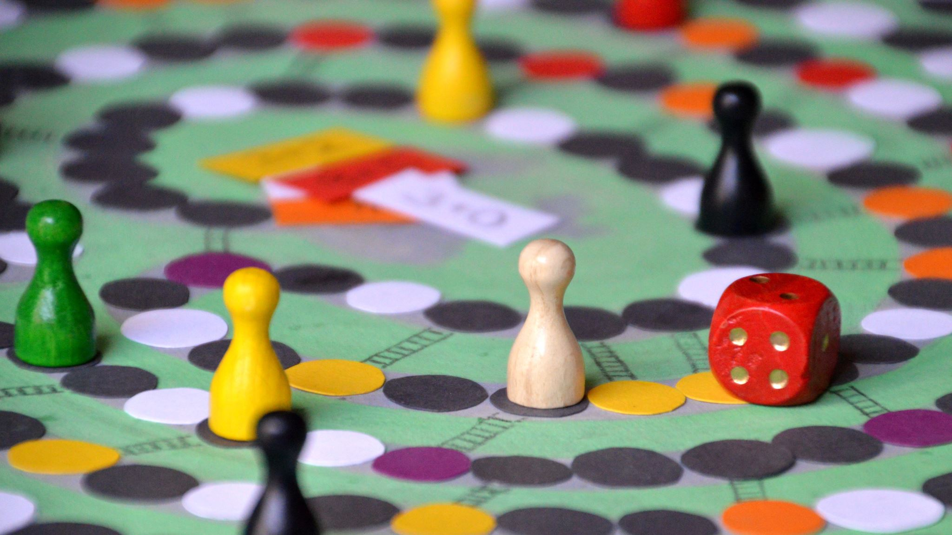
POP QUIZ TIME
Please identify each correctly ☹

Slide 15
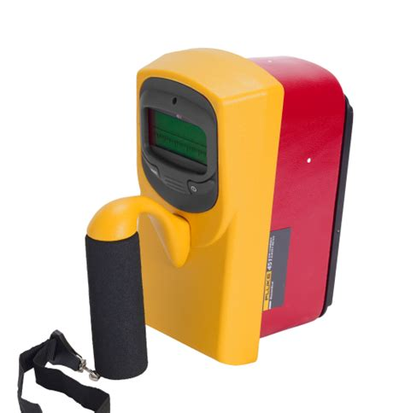

Slide 16
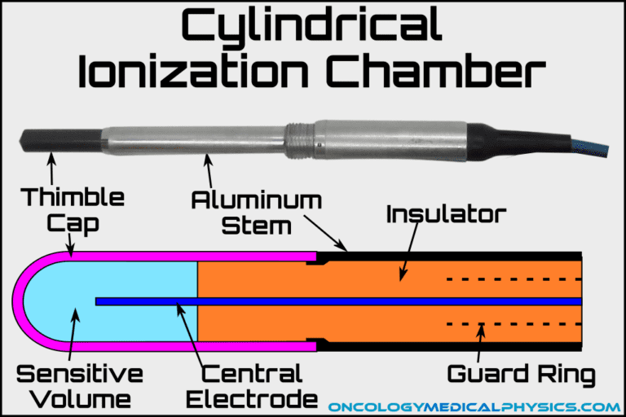
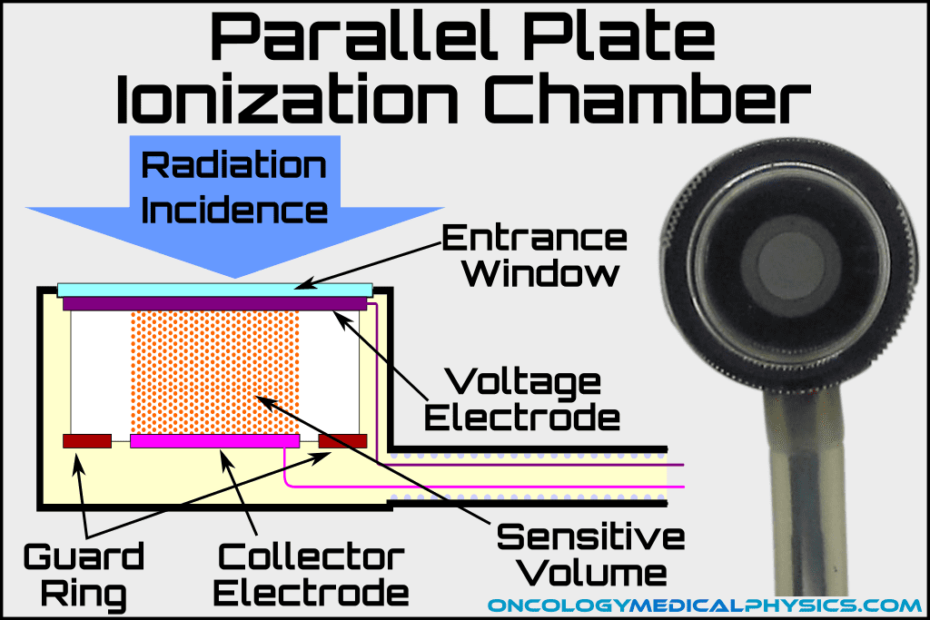

Slide 17
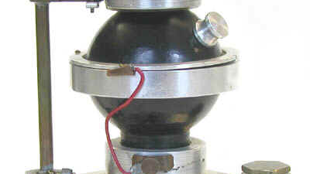

Slide 18
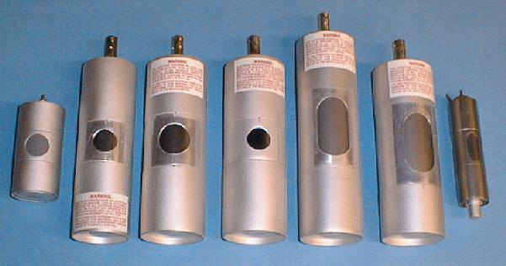

Slide 19
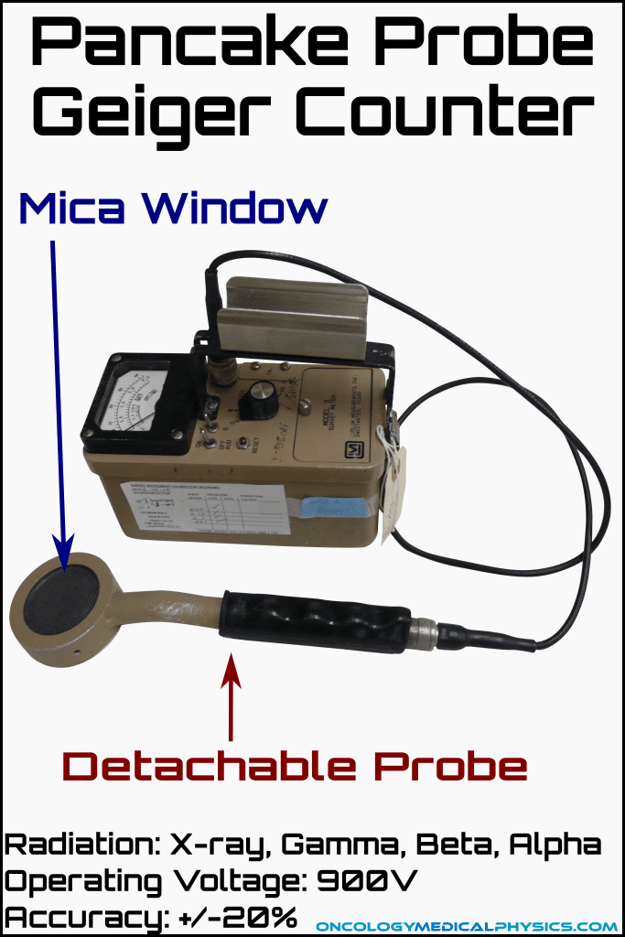

Slide 20
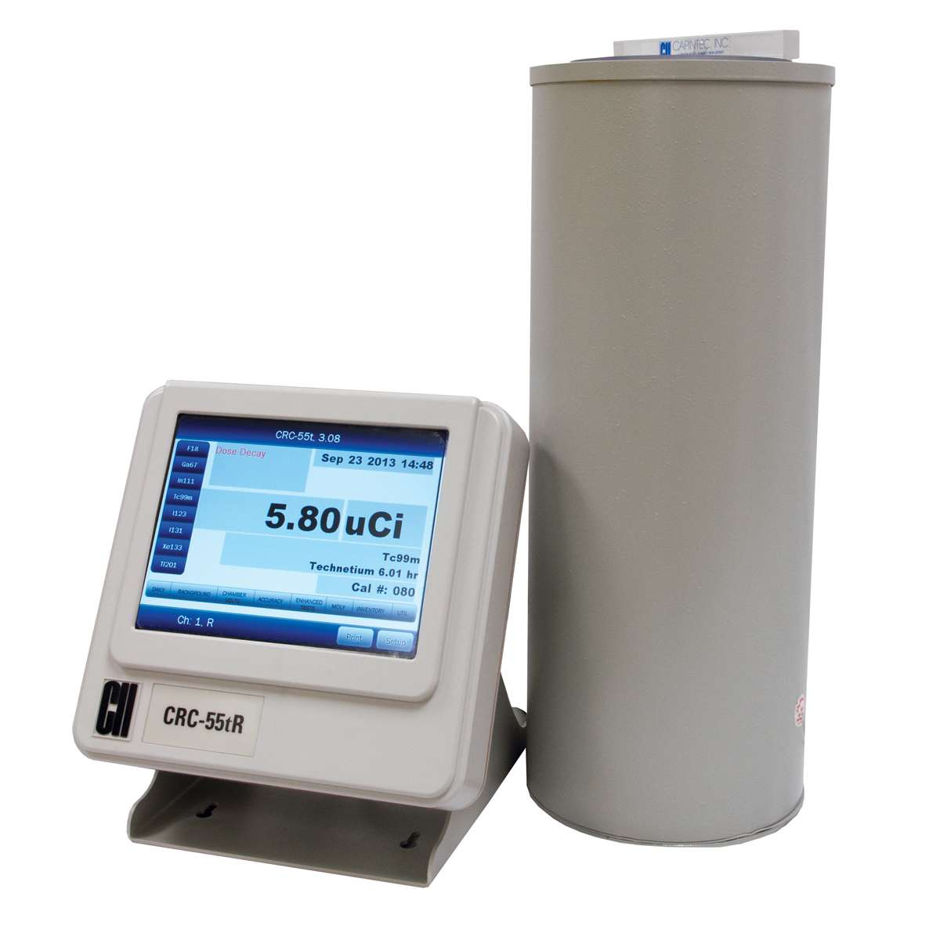

Slide 21
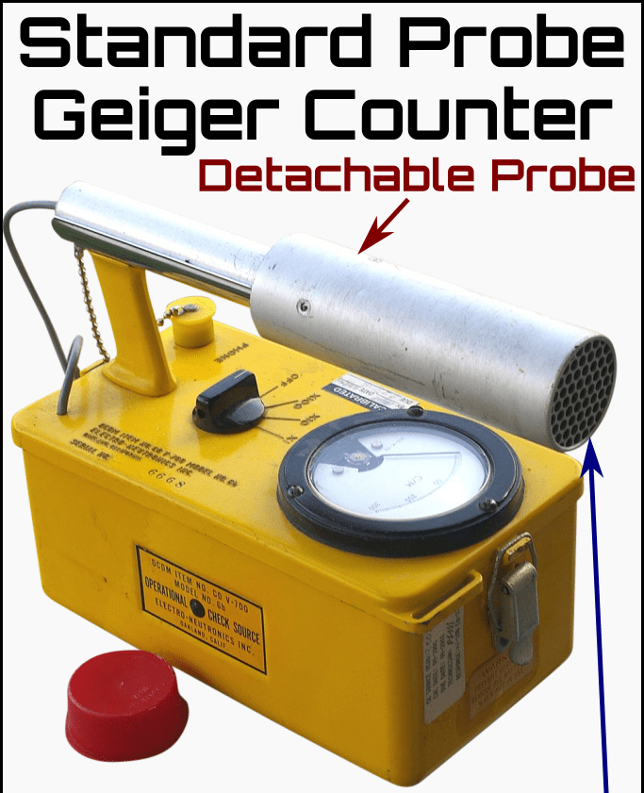

Slide 22
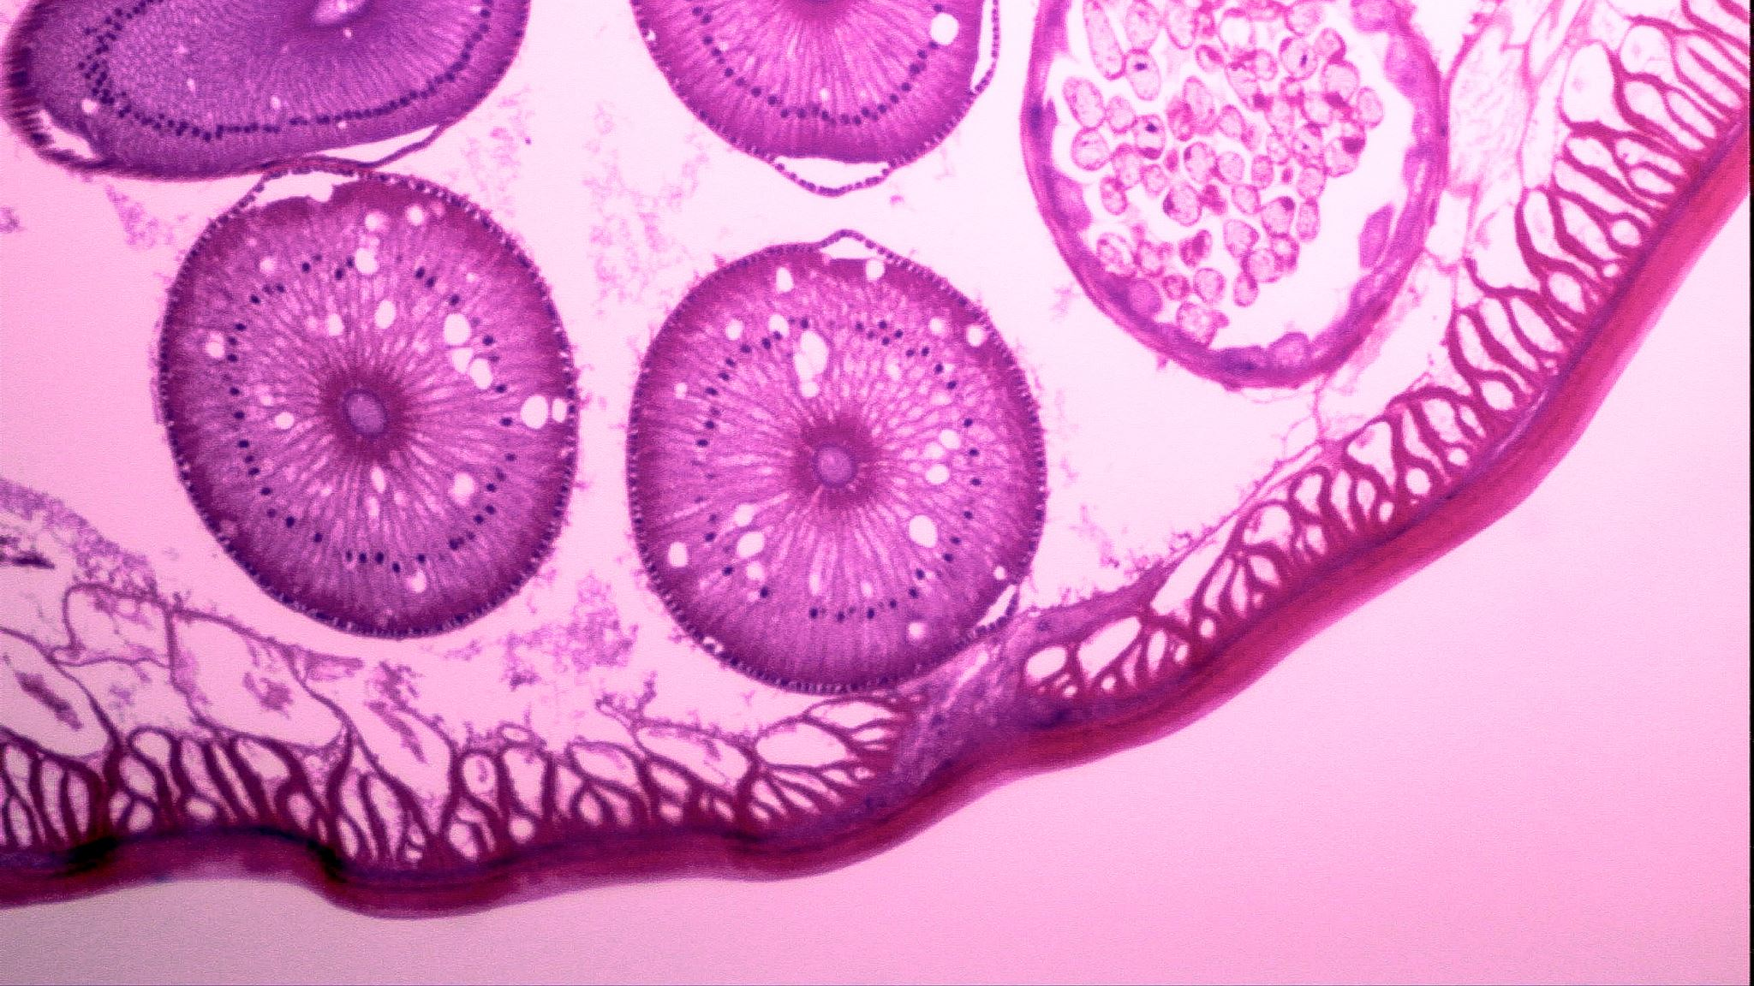
An Overview of Radiopharmaceutical Procedures
Bird’s Eye View,
As The Crow Flys

Slide 23
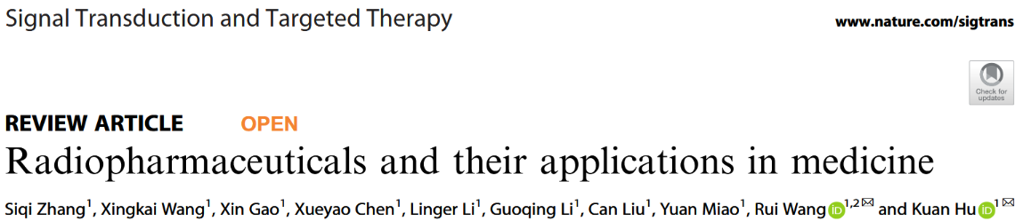
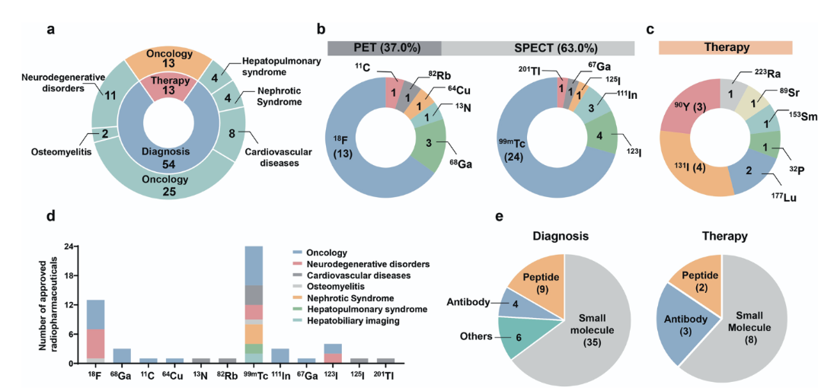

Slide 24
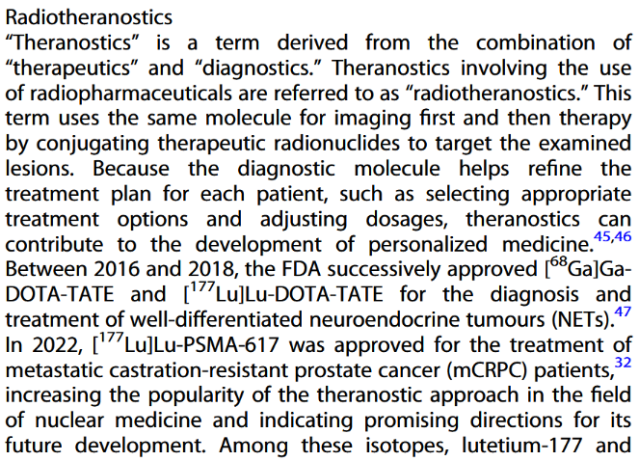

Slide 25
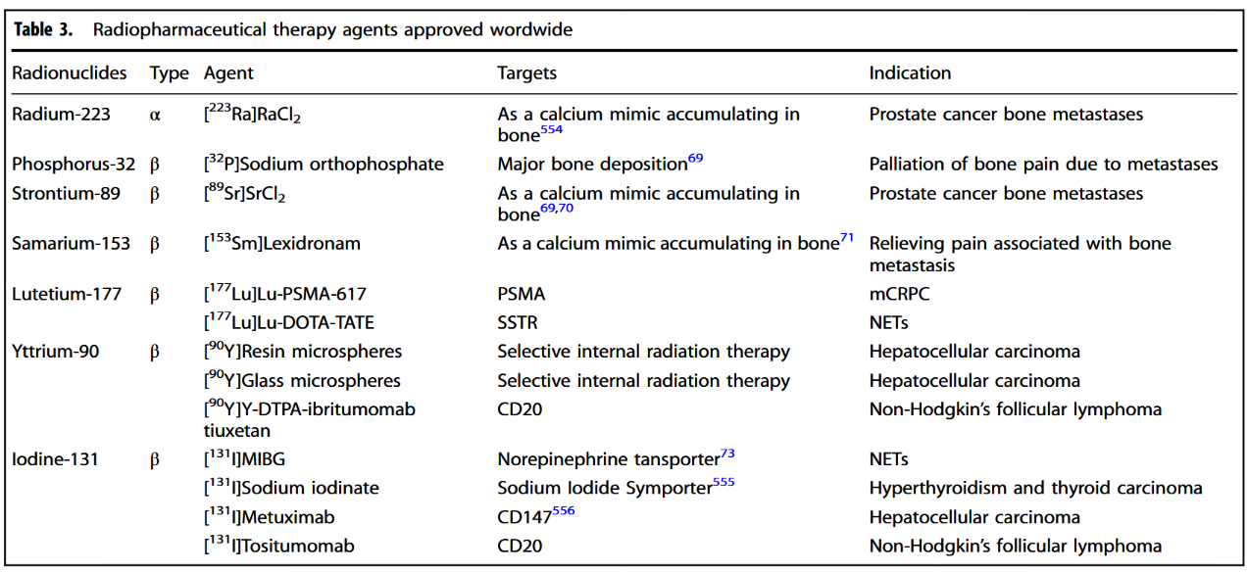
4 Bones
2 Prostate
3 Liver
4 Thyroid

Slide 26
Teaching You What I Know
I’ve only ever seen Lu-177 (prostate) and Ra-223 (bone) here at Karmanos
Pluvicto
Lutathera
Xofigo
I watched a student lecture on Y-90 microspheres (Andrew Lucas!)

Slide 27
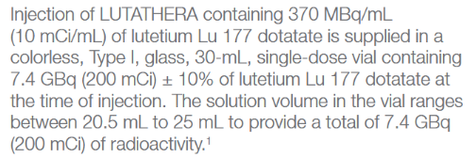
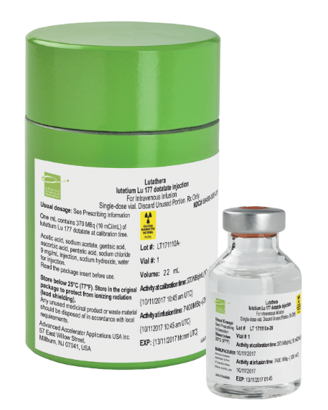
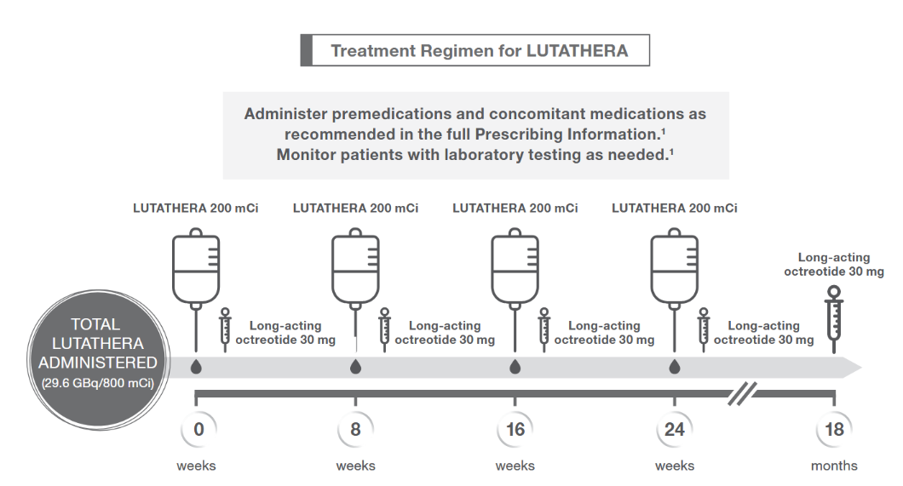
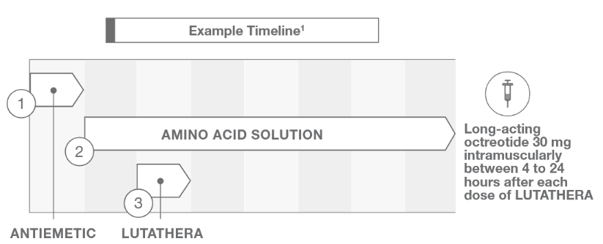
LutaThera
(Lu-DOTA-TATE)

Slide 28
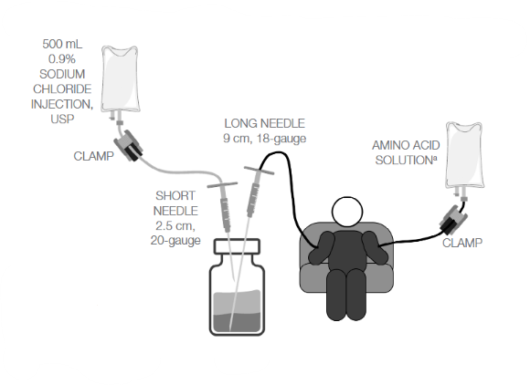
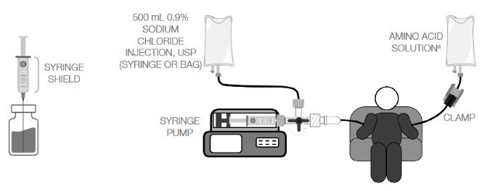
Lutathera Methods

Slide 29
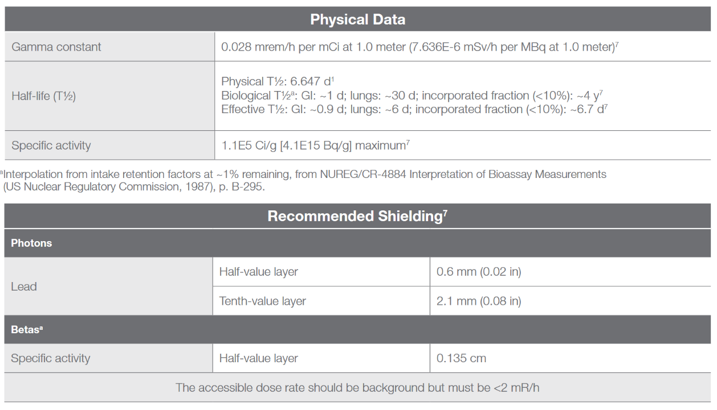
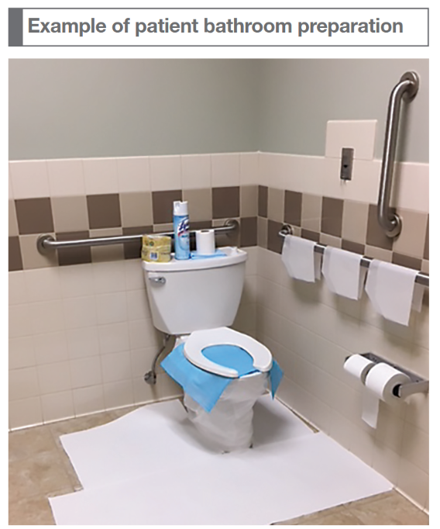

Slide 30
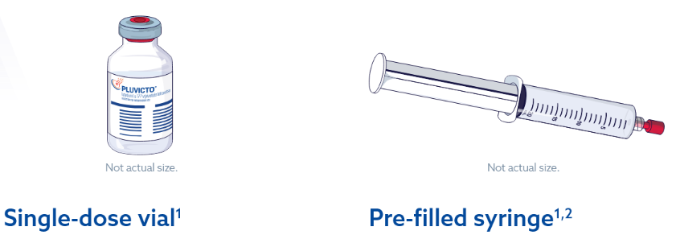
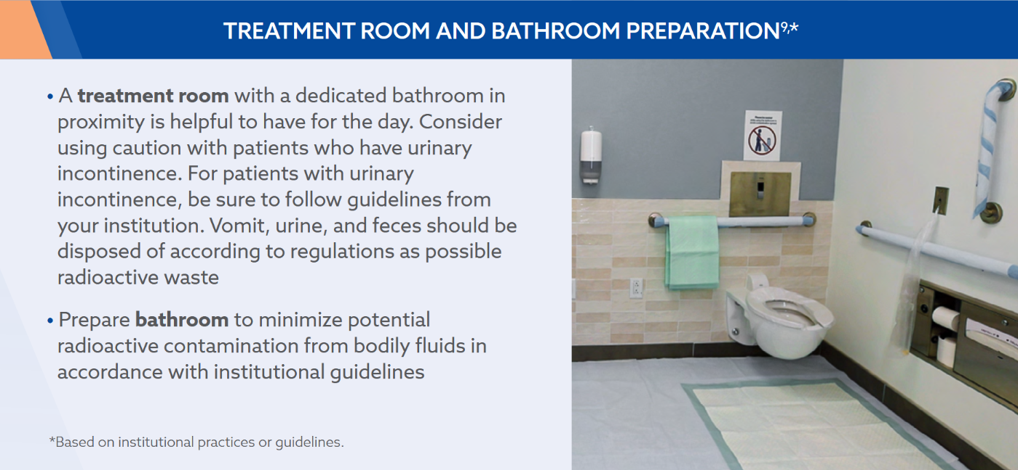
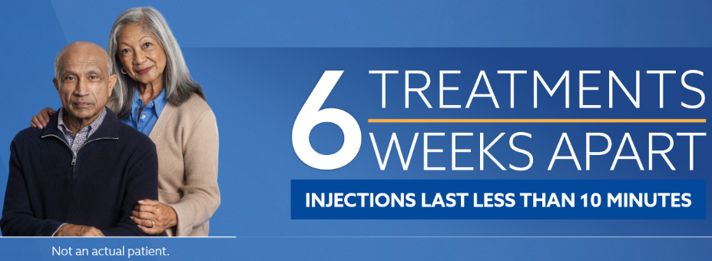
Pluvicto
(Lu-PSMA-617)
Timline:
THERE IS NONE! HAH
1 min push at Karmanos, no other medications

Slide 31
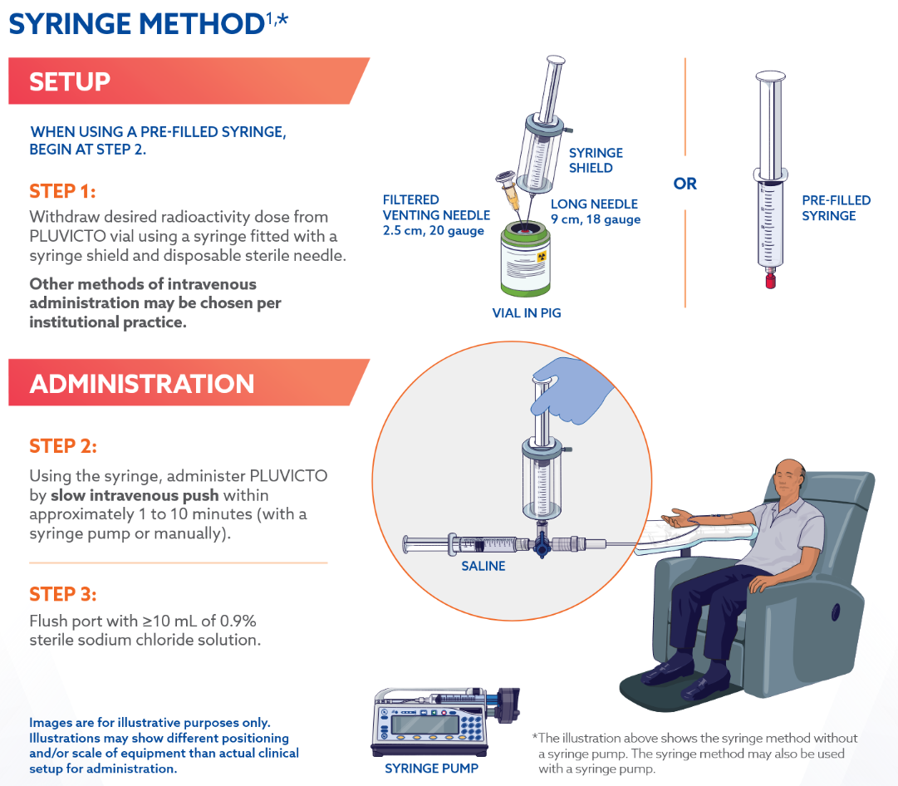

Slide 32
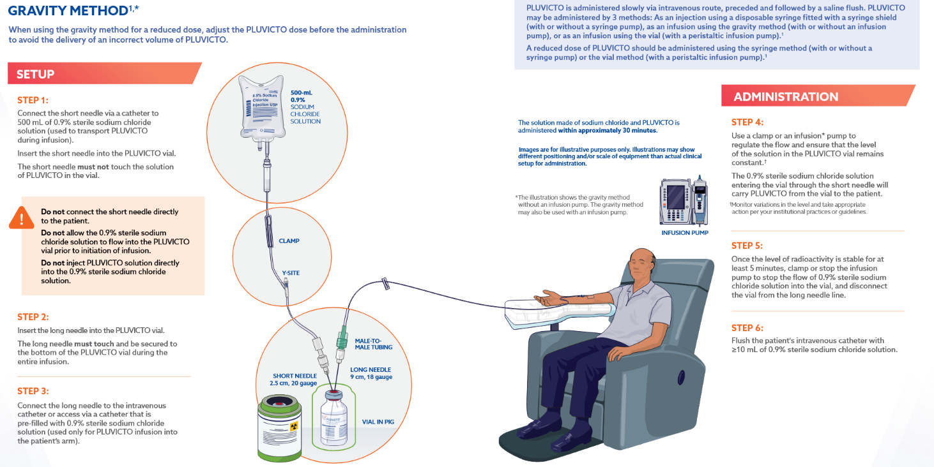

Slide 33
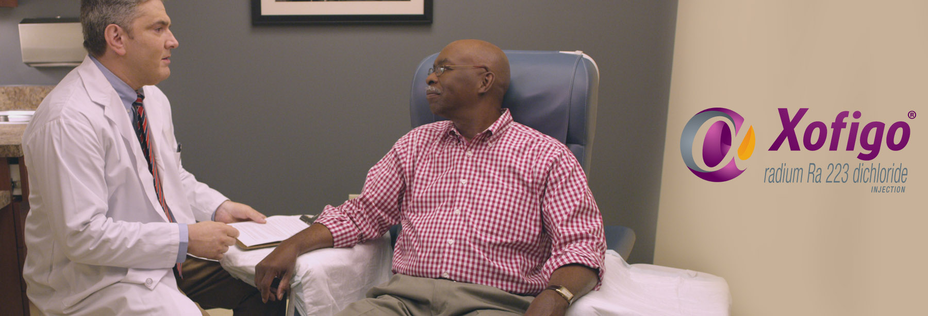
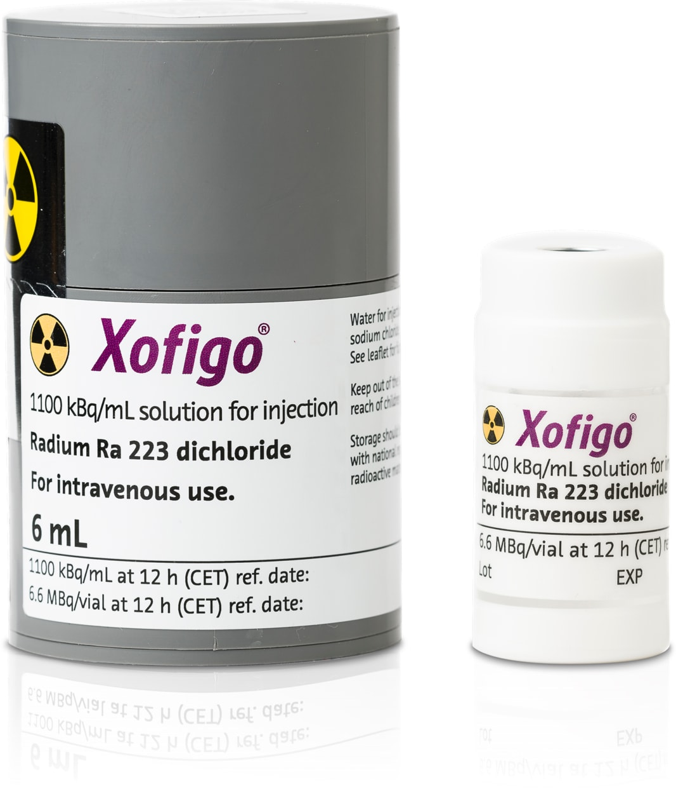
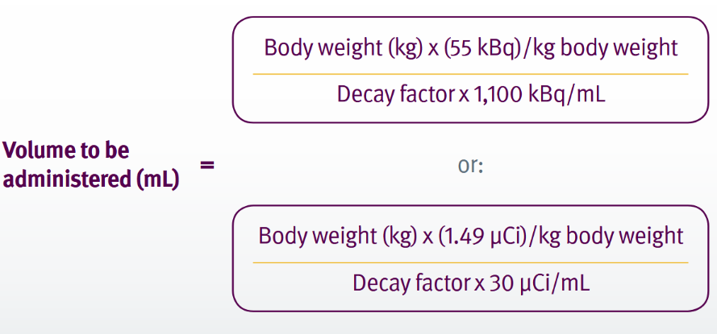
Xofigo
(Ra-Cl₂)

Slide 34
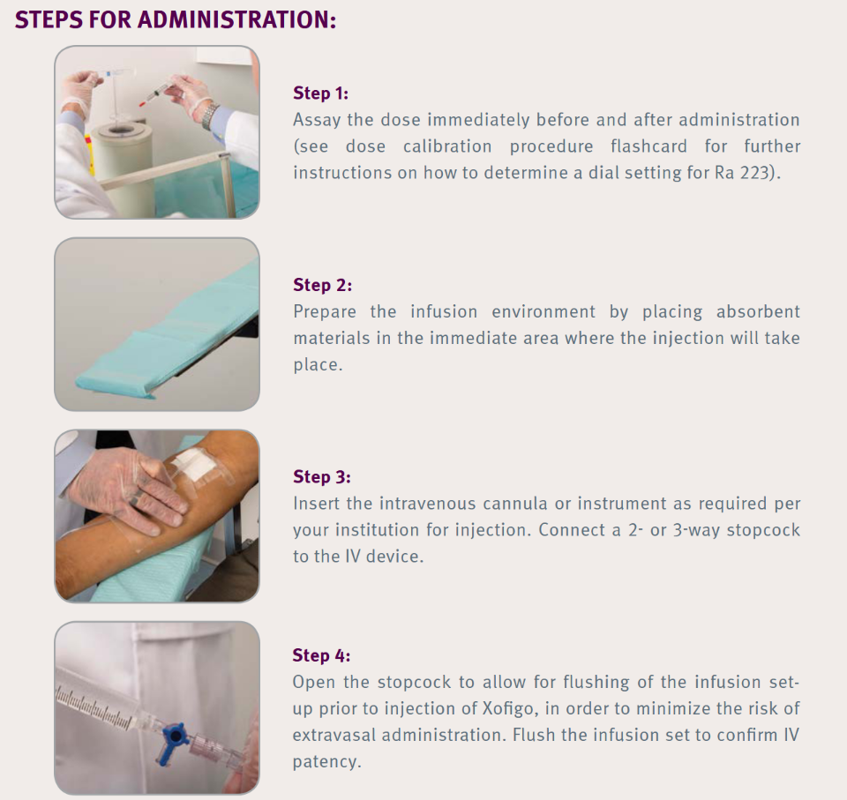
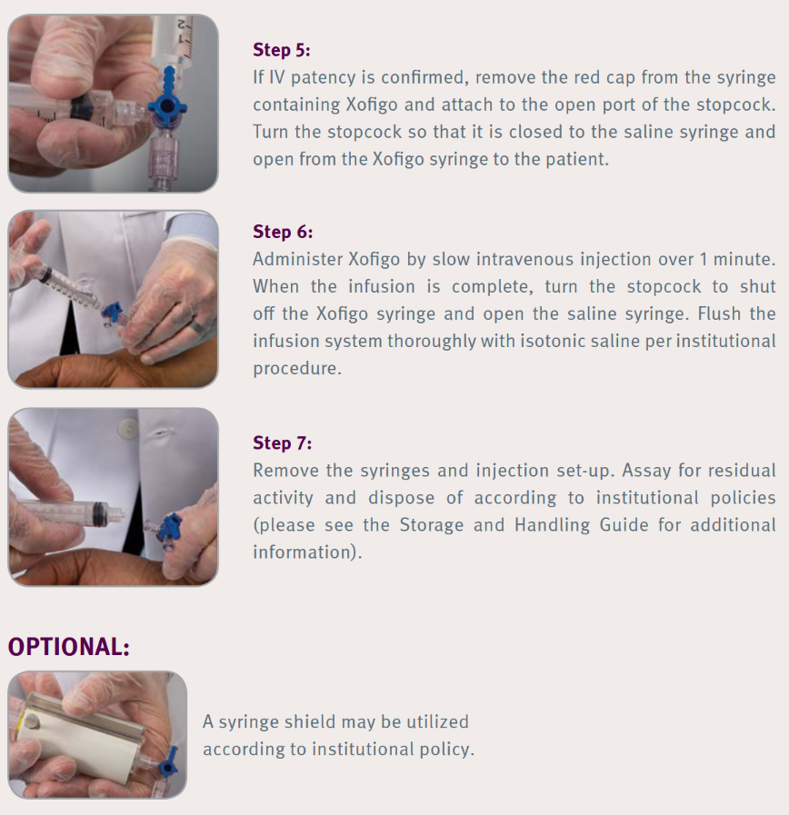

Slide 35

Y-90 Microspheres

Slide 36


What is it?
Tumors / mets are initially supplied by the portal v.
Their size compresses the veins, destroying them
Angiogenic factors signaled in hepatic artery
New, leaky hepatic vessels sprout around tumors
Parenchyma
Tumor
Portal V.
Hepatic A.
Wayne State University
School of Medicine
Thanks Andrew!

Slide 37
Dose Regimens
Single, permanent implant (LDR)
Dose rates ~ 200 Gy / 64 hrs = 3 Gy/hr
40-80 million spheres, 300 Bq / sphere
SIRT may induce cold spots that SBRT can help:
May be delivered in 1, 3, or 5 fractions (8-16 Gy/fx)
Given either daily or every other day
“Fractionation”:
Treat one lobe, let it recover (4-6 weeks), then treat the other
Treat one segment, let it recover (8-12 weeks), then treat it again
Wayne State University
School of Medicine
Thanks Andrew!

Slide 38


